Slide 1
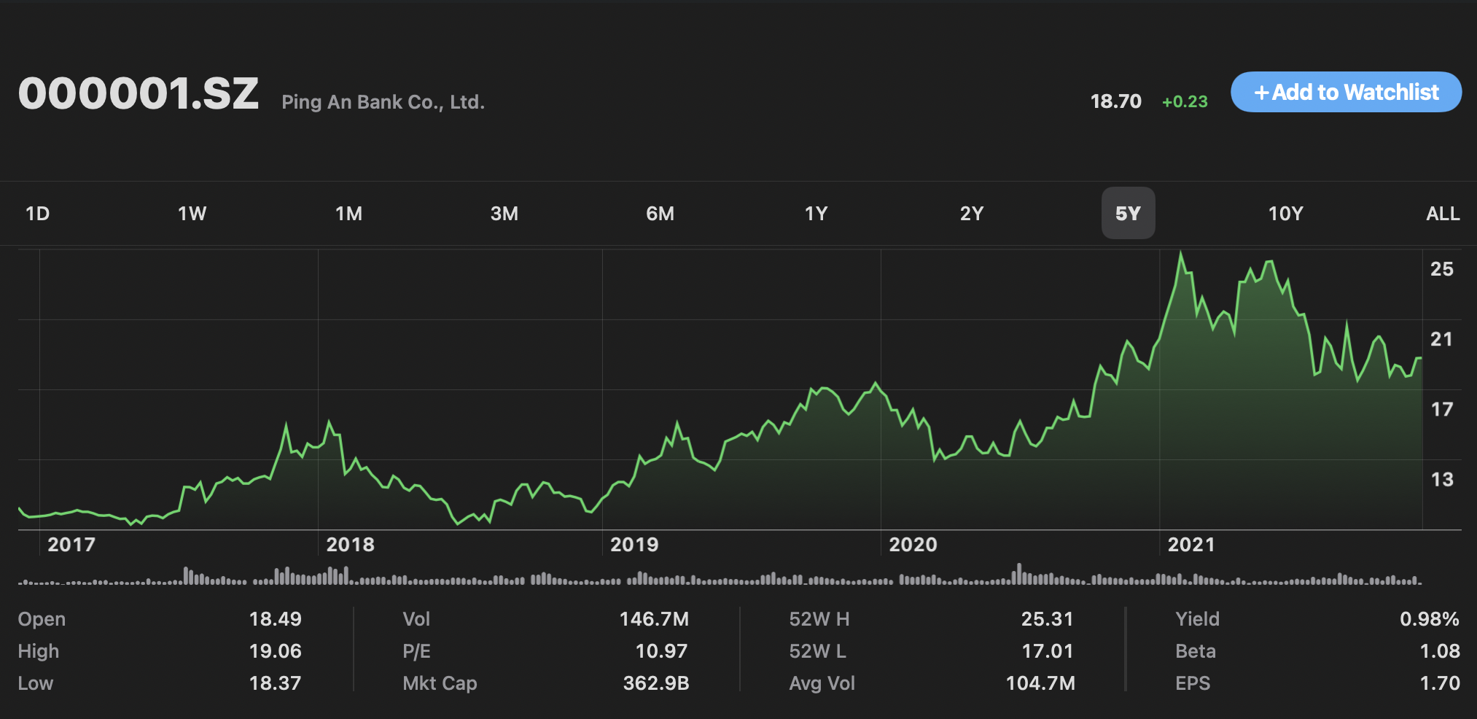
ML Methods for Stock Prices Time Series Prediction
Shuyan Zhang, Zhaozhong Qi, Zemeng Wang

Slide 2
Abstract
Predict stock price in next 1 & 5 & 22 days from previous data
Feature selection (LASSO)
Raw data preprocess (Windowing & Normalization)
Regression and prediction (SVR & KRR)
Result analysis.
Notes:
Use LASSO to select influential features from plenty of factors.
Unify different data to improve performance.
Use SVR and KRR to predict stock price in next 1 & 5 & 22 days.

Slide 3
Dataset Information
Clean small-size dataset for experimenting
Major Dataset
Feature selection:
Diabetes
# example: 442
# feature: 10 (age, sex, bmi, …. )
Regression:
Amazon
# example: 2973 (01/04/2010 - 10/26/2021)
Training data:2010-2019
Testing data: 2019-2021
# feature: 4 (open, close, high, low)
Feature Selection & Regression
Ping an Bank of China
- # example: 4109 (01/04/2005 - 12/02/2021)
Training data: 2005 - 2019
Testing data: 2019 - 2021
- # feature: 30 (EBIT, EBITDA, market_cap, …. )
Notes:
Amazon:
Train and Test split: the scale of the training is 10 years: (dataset(83%)) -, the retaining of the dataset are used for testing(17%, 2 years.)
Ping an bank:
Proportion of dataset: training: around (82%, 15 years), testing (18%, 3 years) Proportion: about 5:1.
Why Amazon dataset, Why PingAn dataset?
SVR’s Decision model could not perform very well when the data set has more noise.
Amazon and Ping an bank are well known listed company around the worldwide. Amazon: the most valuable U.S.-based internet company by market capitalization. Ping an Bank: The third market capitalization in ShenZhen stock exchange.
Pros:
More regulatory and less fluctuation on account of uncertainty factors. Just like the most of the mood fluctuation factors in financial, etc.
Even relative stabilization,but still non-linearity model based on nearly 16 years historical data since created.
Factors are more reasonable based on objective law of the statistics and following the universal law of financial markets.
Cons:
Non-universality, not persuadable for all possibility situation for all stocks. High sensitively and volatile stock, such as Tesla.
No enough extension of factors, not reasonable to involve Risk and Style factor to very large company such as bank. Etc. Residual_volatility factors
Factors list amazon: Basic factors: open, close, high, low
Factor list Ping An:
Basic subjects and derivative factors: financial_expense_ttm， market_capitalization, circular, net_debt, interest_carry_current_liability
Technical index factor: 10 days simple moving average(MAC10), 5-day exponential moving average(negative-relation)

Slide 4
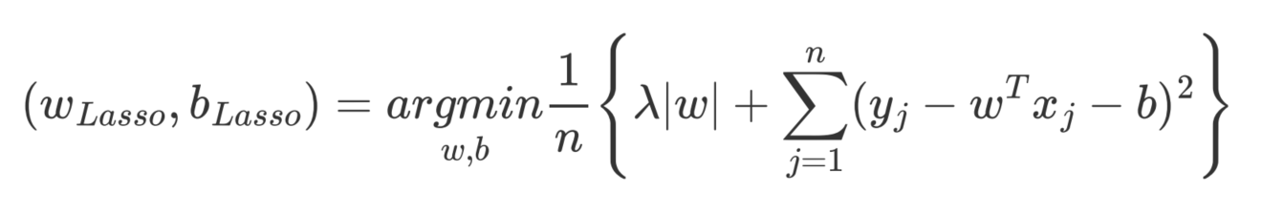
Feature Selection
Factors of Data Resource (among 30 factors)
Least Absolute Shrinkage and Selection Operator (LASSO)
λ denotes the amount of shrinkage
λ = 0 implies all features are considered
λ = ∞ implies no feature is considered
Notes:
Lasso regression is very similar to Ridge regression, but it uses an l1 penalty.
Ridge regression uses the L2 term, which is equal to the square of the magnitude of the coefficients.
Lasso regression will automatically select those features that are useful, discarding the useless or redundant features, in order to minimize the cost function.
Lambda = 0 it is equivalent to the linear regression where only the residual sum of squares are considered to build a predictive model
Lambda = infinity ,it eliminates more and more features.
Again, like Ridge regression, we need to scale the features in advance in order to make them comparable.

Slide 5
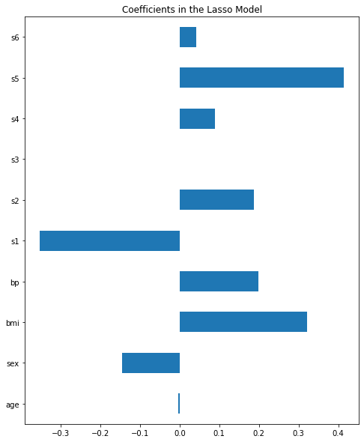
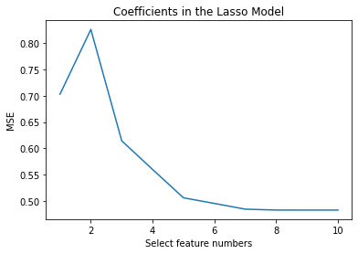
Feature Selection (Diabetes)
Lasso coefficients / regularization Lambda parameter
Elbow method
Lasso selected Feature:
[ S5(i), BMI(i), S1(i), BP(i), S2(i) ]
Notes:
So, the idea of using Lasso for feature selection purposes is very simple:
we fit a Lasso regression on a scaled version of our dataset and we consider only those features that have a coefficient different from 0.
We use 5-fold cross validation to select the most appropriate lambda, which is the regularization parameter
Then we can get the weight of each feature in regression.
Then lasso suggests us that these factors are more relevant to the prediction of results.
Then we sort the weights according to the absolute value from large to small, increase the number of selected features according to the weight,
and restore the value of the original label according to these features and corresponding weights
Then we calculate the Mean square error with original label value in order to decide how many features to choose is the best choice using elbow method.

Slide 6
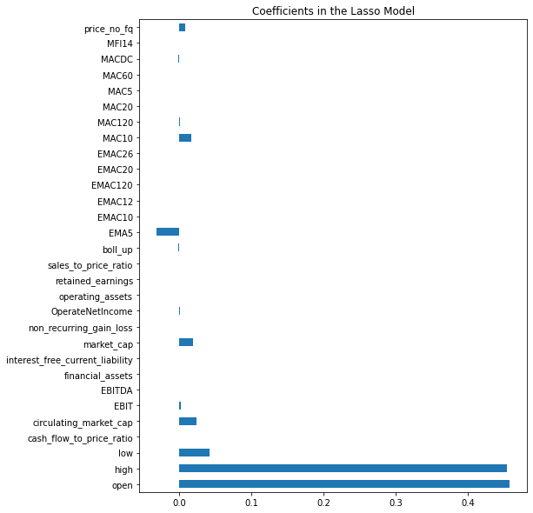
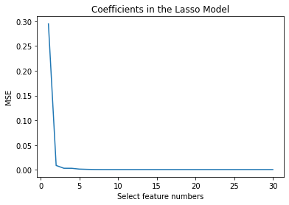
Feature Selection (PingAn Bank)
Lasso coefficients / regularization Alpha parameter
Elbow method
Lasso selected Feature:
[ High(i), Low(i), Open(i), EMA5(i), Market_cap(i),
circulating_market_cap(i) ] => Close(i+1)
Notes:
Then we apply this method to the data of Ping An Bank.
There are 30 Basic factors in this dataset.
so we try to use lasso to eliminate the factors with weak correlation, and select the factors that are more relevant to the closing price.
Lasso picked 17 variables and eliminated the other 13 variables
After retrieving the dataset with selected features and calculating the mean squared error, we can surprisingly find that only a few factors that is closely related.
So we just selected 6 features to form the dataset, including high, low, open, close, EMA5, Market_cap and circulating_market_cap, and using these factors to predict closing prices for the next few days.

Slide 7
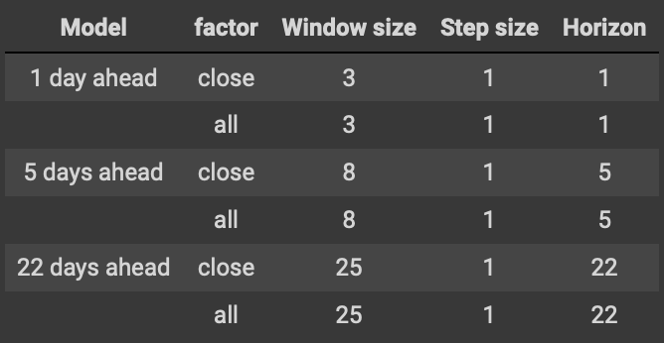
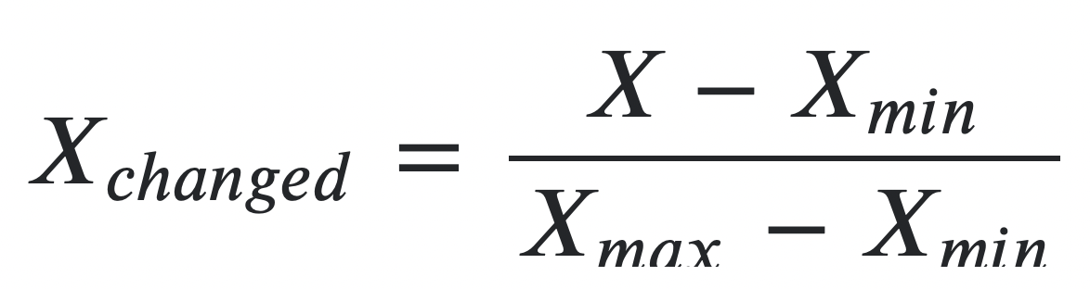
Data Preprocess
Normalization
Windowing
Normal Rectangular Window
Window size
Step size
Horizon
Data Normalization
MinMaxScalar
Range of [0,1]
High(i), Low(i), Open(i), EMA5(i), Market_cap(i), circulating_market_cap(i)
=> Close(i + horizon)
Notes:
Because we are trying to use the past data to predict future, we used the normal rectangular window to transform the original dataset into a new form.
That is, using the several days’ factor data as the feature part, and the future close price as the label. window size means how many days of data from the past are used. horizon means predicting the closing price of the first few days of the future. Then we can get a dataset that using the historical data to predict the future closing price.
Why need to normalize the data
Different factor has different unit, If not regularized, it can have a significant negative impact on the prediction results.
Why use MinMaxScaler rather than StandardScaler
MinMaxScalar can be used as the first scaler choice to transform a feature, as it will preserve the shape of the dataset with no distortion, which is important. StandardScalar will transform each value in the column to range about the mean 0 and standard deviation 1, This is suitable for cases where it is known in advance that the data is normally distributed, but we are dealing with time series data, we do not care about the distribution of the data, and the data is not normally distributed, so we do not use this.

Slide 8
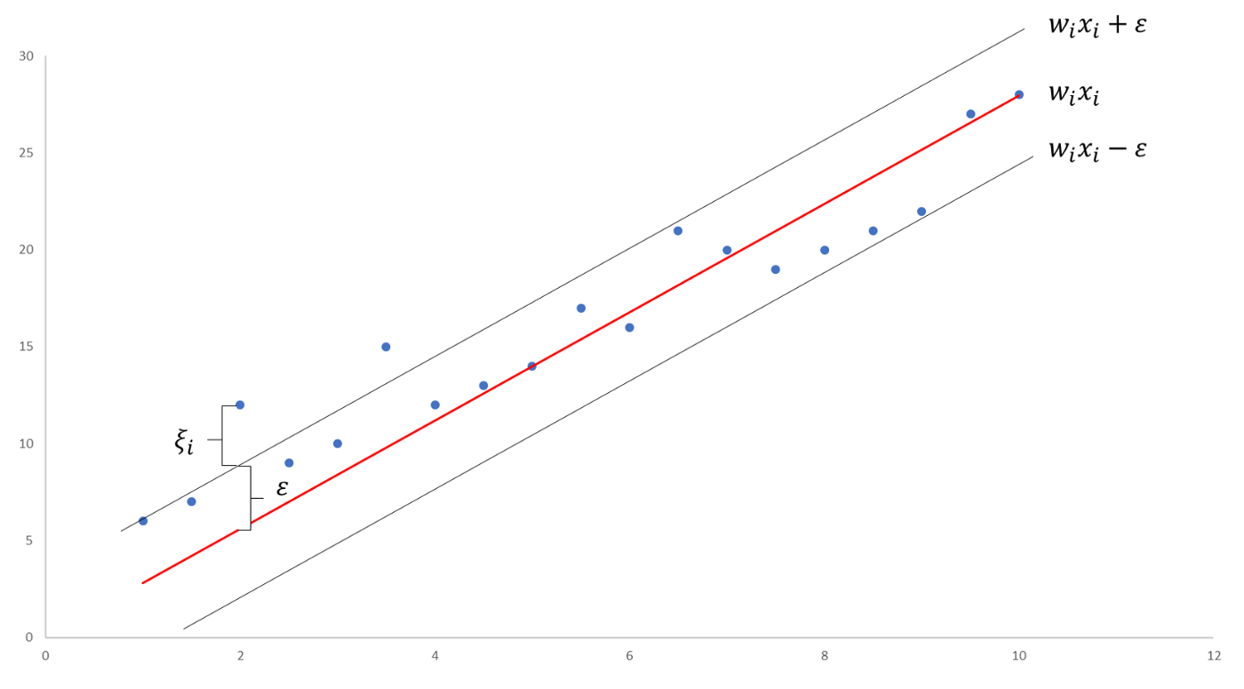

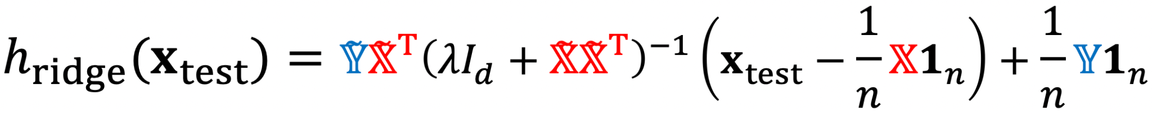
Regression model
SVR & KRR
Support Vector Regression
From SVM
With kernel (RBF)
Kernel Ridge Regression
Use ridge to avoid overfitting
Notes:
Central idea of model is to employ a non-linear prediction function and prevent overfitting.
Support Vector Regression is a supervised learning algorithm that is used to predict discrete values.
It uses the same principle as SVM, but the best fit line in SVR is the hyperplane that has the maximum number of points.
We use RBF kernel in prediction. The parameters are obtained from grid search.
SVR prevents overfitting by using tolerance, epsilon. Support vectors are the points out of the tube boundaries.
Kernel Ridge Regression use ridge to avoid overfitting, which has been mentioned in the lecture.
/////////////////////////////////
In practice, we use grid search to obtain hyperparameter value.
Pros:
It is robust to outliers.
Decision model can be easily updated.
It has excellent generalization capability, with high prediction accuracy.
Its implementation is easy.
Cons:
They are not suitable for large datasets.
In cases where the number of features for each data point exceeds the number of training data samples, the SVM will underperform.
The Decision model does not perform very well when the data set has more noise

Slide 9
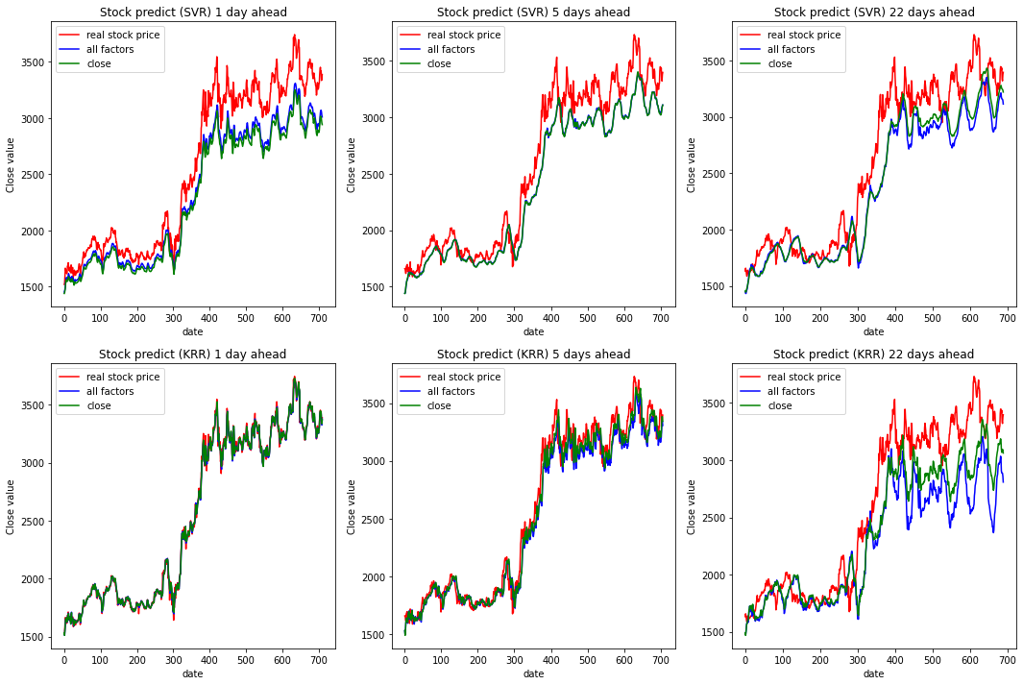
Regression result (Amazon)
Notes:
We first use Amazon data to test regression model.
The red line is the true stock price in data.
Green line is the result of regression model just with close price.
Blue line is the result with all factors.
We can see KRR performs better than SVR in 1 day and 5 days ahead prediction.
But the performance in 22 days ahead prediction is not so good.

Slide 10
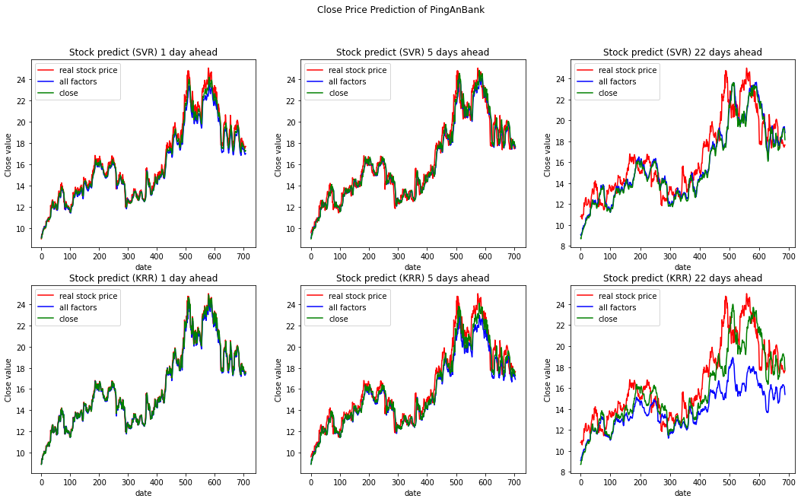
Regression result (PingAn Bank)
Notes:
There are the prediction results of PingAn Bank in 1 day, 5 days, 22 days ahead.
SVR and KRR seems good in 1 day and 5 days prediction.
But with a little lag and lower prediction compared to the real stock price in 22 days.

Slide 11
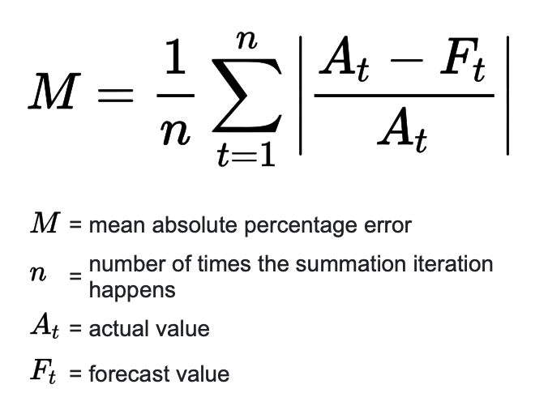
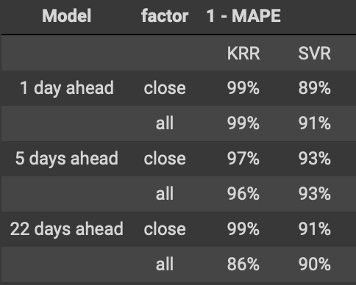
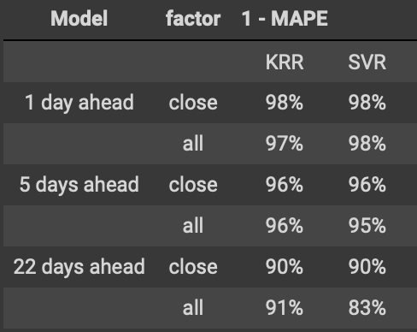
Evaluation
Mean Absolute Percentage Error
Amazon:
PingAn Bank:
Notes:
Why use MAPE rather than MSE
MSE is scale-dependent, MAPE is not. In this case, we are comparing accuracy across time series with different scales, we can't use MSE.\
The predictions are pretty good.

Slide 12
Prospect
More reasonable factors (feature) selection ahead with Lasso.
Missing data handling,
Optimize parameter-tuning method
LSTM Model (Keras’ Long Short-Term Memory)
Note: This is not a project claiming that this technology will make you millions because it absolutely won’t.
Notes:
More reasonable feature selection:
More categorical of the feature vectors. Research about accurate physical elements v.s. psychological factors of the background of the company.
Uncompleted Data: Missing time series data in certain cases. Such as in some cases. Access K-means, K-NN, Random forest,
LSTM: https://www.analyticsvidhya.com/blog/2021/05/stock-price-prediction-and-forecasting-using-stacked-lstm/
Pros:
LSTMs are widely used for sequence prediction problems and have proven to be extremely effective.
LSTM can store past important information and forget the information that is not.
Specifically in time series data, In time-series data the one data is dependent on other data

Slide 13
Q & A

